Slide 1
BRITISH VS AMERICAN
MARIALENA SOFRONIOU
ST ‘3

Slide 2
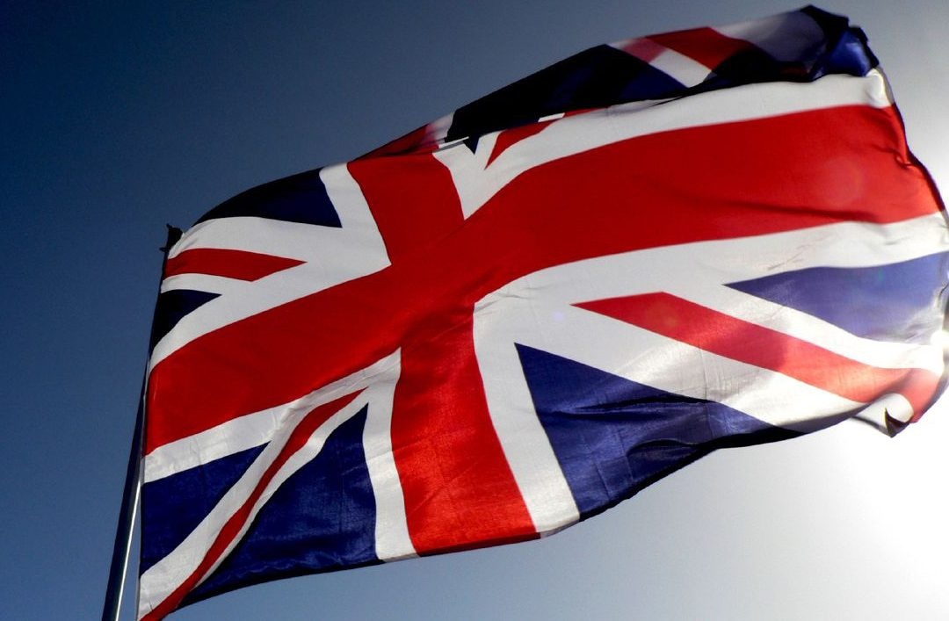
BRITISH
BRITISH
1.CHIPS
2.CRISPS
3.COURGETTE
4.ROLL
5.SWEETS
6.JAM
7.ICE LOLLY
8.BISCUIT
BRITISH
BRITISH
BRITISH

Slide 3
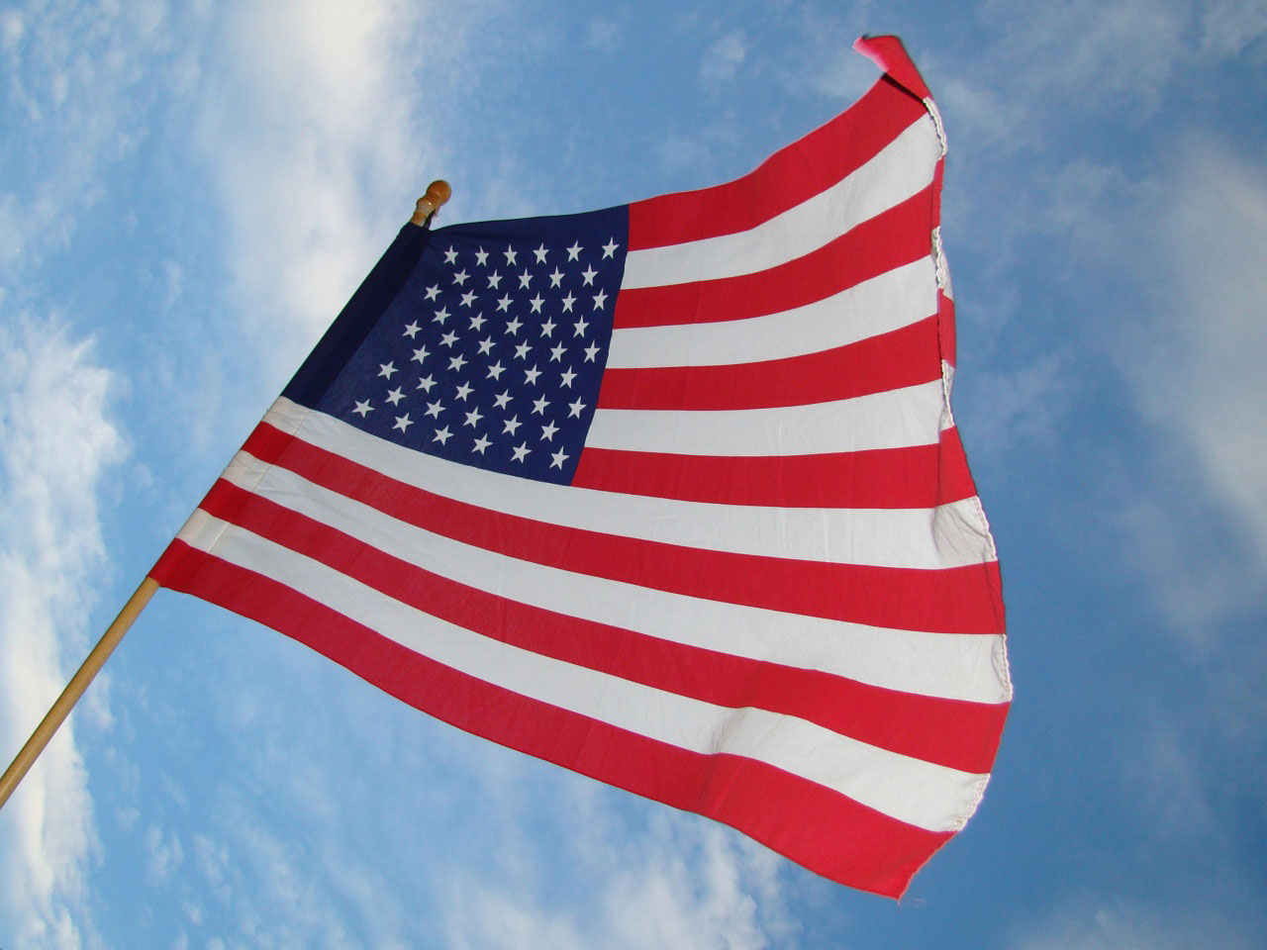
AMERICAN
1.FRIES
2.CHIPS
3.ZUCCHINI
4.SUD
5.CANDY
6.JELLY
7.POPSICLE
8.COOKIE
AMERICAN
AMERICAN
AMERICAN
AMERICAN

Slide 4
thank you for watcing

