Slide 1
BRITISH VS AMERICAN ENGLISH
ANDRIANA NEOPHYTIDOY ST2

Slide 2
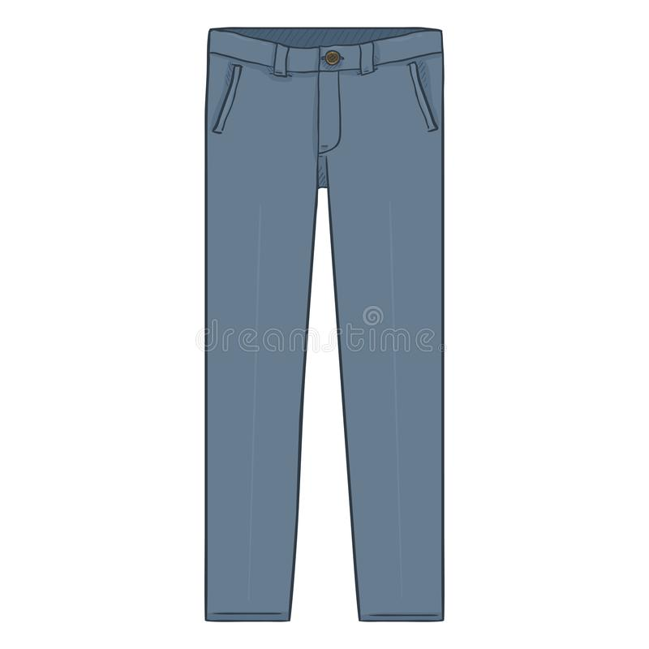
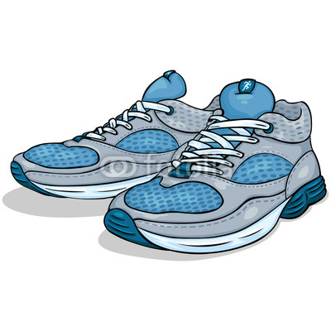
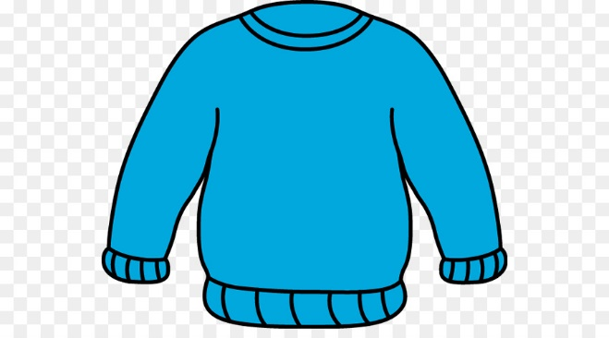
British English VS American English
CLOTHES
trousers
pants
trainers
sneakers
jamper
sweater

Slide 3
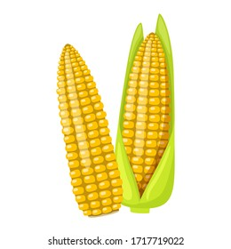
British English VS American English
FOOD
beetroot
beet
maize
corn
fairy cake
cap cake
gammon
ham

Slide 4
THANK YOU FOR WATCHING

